Slide 1

@wwcodeportland

Slide 2
Women Who Code
Women Who Code (WWCode) is a global 501(c)(3) non-profit dedicated to INSPIRING women to EXCEL in technology careers.
Organization Overview
501(c)(3): #46-4218859

Slide 3
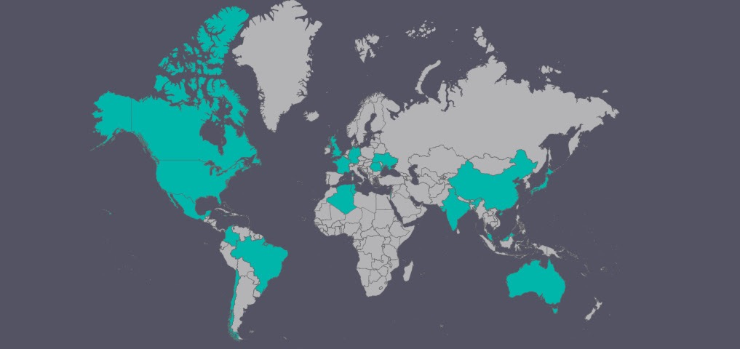
60,000+ members
60+ cities
20+ countries

Slide 4
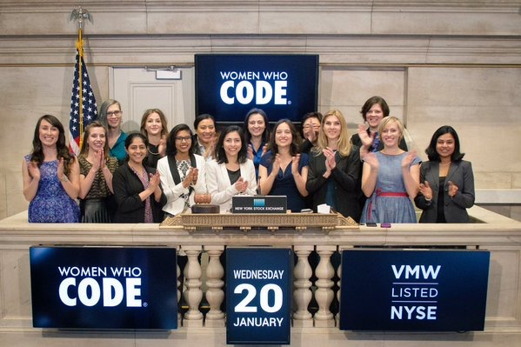
Women Who Code @ NYSE

Slide 5
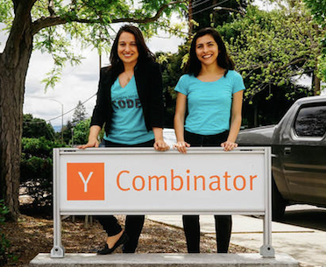
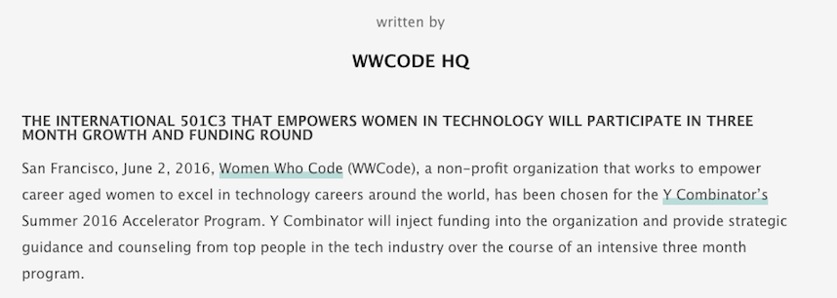
Women Who Code
+ Y Combinator

Slide 6

Portland

Slide 7




Founded: June 10, 2014
1300+ members
meetup.com/women-who-code-portland
@WWCodePortland
wwcodeportland.slack.com

Slide 8
Leadership Team
Caterina - Director
Paige - Director
Sabina - Event Lead
Richa - Skills Development Lead
Amara - Community Lead
Sarah Joy - JavaScript Lead (in-training)
Shiyuan - Design Lead (in-training)
Tricia - DevOps Lead (in-training)
==> contact us: portland@womenwhocode.com

Slide 9































Portland Events
Networking Nights
Workshops
Study Nights
Social Events
Women Who Strength Train
Airbnb House at CONNECT 2016 in Seattle, WA

Slide 10
Study Nights
SUBJECTS:
Javascript (twice a month)
Design
DevOps
Big Data
LOCATIONS: downtown, westside

Slide 11
Workshops
PAST:
Prototyping in Bootstrap and Foundation
iOS vs. Android Development
React Native
Git, GitHub, and Contributing to Open Source
FUTURE:
Intro to IoT (Internet of Things)
Intro to Command Line

Slide 12

IoT Hackathon
24-hr Hackathon:
Nov. 11-13th
Workshop:
Oct. 20th

Slide 13
Networking Night
What? A meetup hosted by a different tech company in Portland every month.
The goal is to introduce our members to new companies, careers in tech, and to showcase women in engineering, design, product management, etc working at those companies.
Why? We want to build a community.

Slide 14
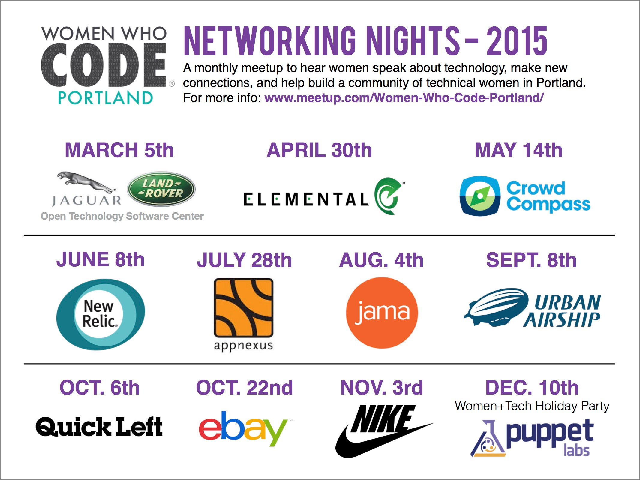

Slide 15
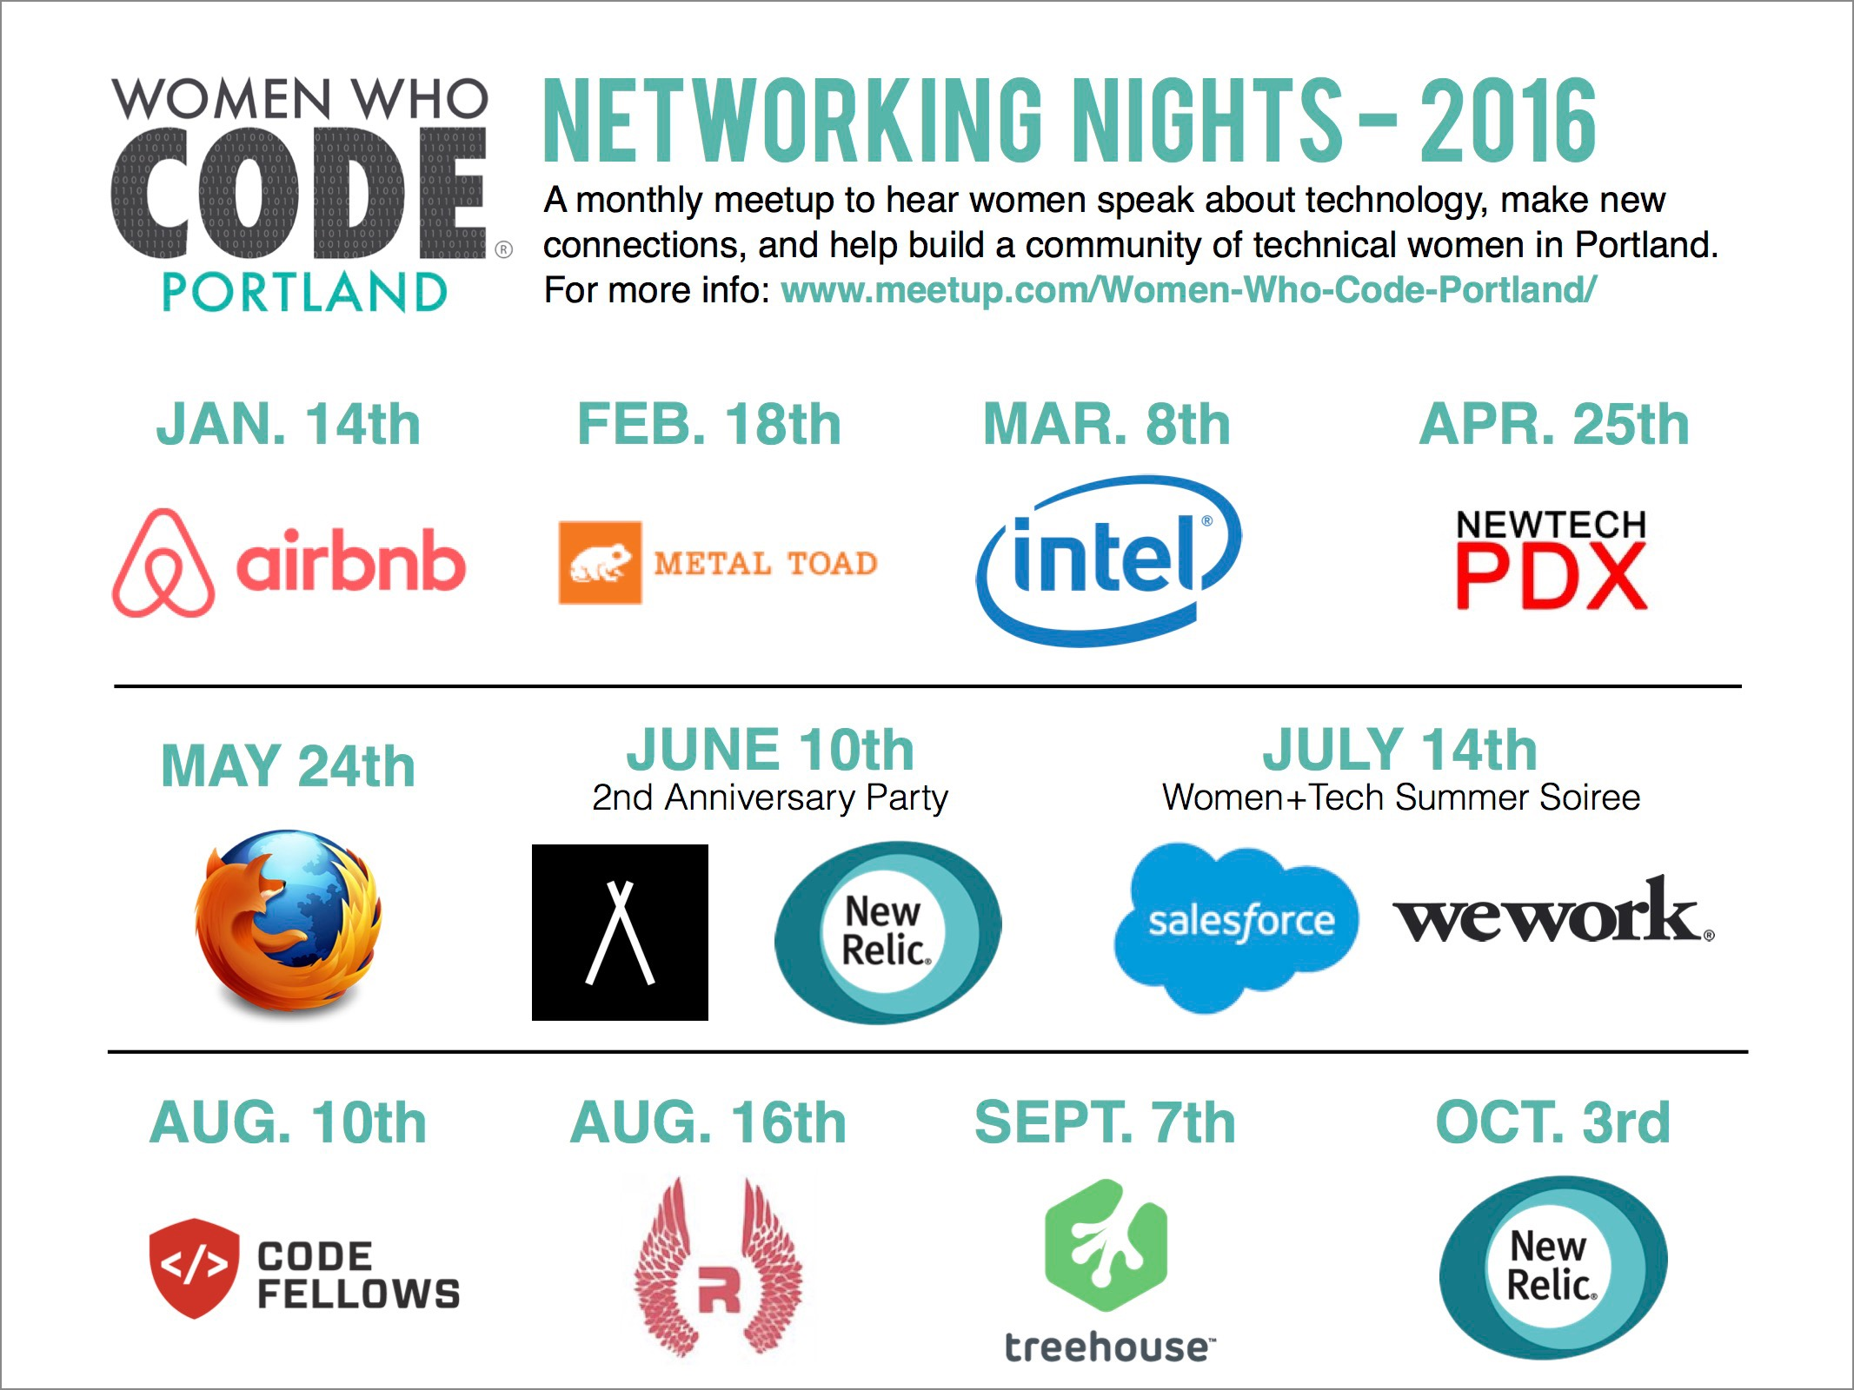

Slide 16
Upcoming Events
Networking Night @ R/West: “Women in Leadership”
Aug. 16th - 6 PM
Networking Night @ Treehouse
Sept. 7th - 6 PM
Big Data and Machine Learning Night
Sept. 13 - 5:30 PM
Networking Night @ New Relic (Resolution Fest 2016)
Oct. 3rd - 5:30 PM

Slide 17
How to Get Involved

Slide 18
Want to get more involved?
AS A MEMBER: volunteer at an event, co-lead a study night, teach a workshop, take on a leadership role
AS A DEVELOPER: lead or co-lead a study night, teach or co-teach a workshop
AS A COMPANY: host us for a study night, a workshop, or a Networking Night, sponsor our IoT Hackathon

Slide 19

Join us!

Slide 20
Questions?
portland@womenwhocode.com

